Slide 1
INSTRUCTION FORMATS AND ADDRESSING MODES

Slide 2
INSTRUCTION FORMATS
An instruction format defines the layout of the bits of an instruction, in terms of its constituent’s fields. An instruction format must include an opcode and implicitly or explicitly, zero or more operands. The format must implicitly explicitly, indicate the addressing mode for each operands. For most instruction sets, more than one instruction format is used.

Slide 3
INSTRUCTION LENGTH
The most basic design issue to be faced is the instruction format length. This decisions effects and is affected by, memory size, memory organization bus structure process complexity and processor speed. This decision determines the richness and flexibility of the machine.

Slide 4
INSTRUCTION SETS CHARACTERISTICS
The operation of the processor is determined by the instructions it executes referred to as machine instructions or computer instruction. The collection of different instructions that the processor can execute is referred to as the processors instruction set.

Slide 5
ELEMENTS OF A MACHINE INSTRUCTION
These elements are as follows:
      Operation code: Specifies the operation to be performed (e.g, ADD, I/O). The operation is specified by a binary code, known as the operation code or opcode.
      Source operand reference: This operation may involve one or more source operands, that is operands that are inputs for the operation
      Results operands reference: The operation may produce a result
      Next instruction reference: This tells the processor where to fetch the next instruction after the execution of this instruction is complete.

Slide 6
The address of the next instruction to be fetched could be either a real address or a virtual address, depending on the architecture. Generally, the distinction is transparent to the instruction set architecture. In most cases, the next instruction to be fetched immediately follows the current instruction. In most cases, there is no explicit reference to the next instruction when an explicit reference is needed then the main memory or virtual memory address must be supplied. Source and result operands can be in one of four areas.
      Main or virtual memory: As with next instruction references, the main or virtual memory address must be supplied.
      Processor register: With rare exception a processor contains one or more registers that may be referenced by machine instructions. If only one registers exits reference to it may be implicit. If more than one register exists, then each register is assigned a unique name or number, and the instruction must contain the number of the designed register

Slide 7
      Immediate: The value of the operand is contained in a field in the instruction being executed.
      I/O device: The instruction must specify the I/O module and device for the operation. If memory-mapped I/O is used, this is just another main or virtual memory address

Slide 8
INSTRUCTION REPRESENTATION
Within the computer, each instruction is represented by a sequence of bits. The instruction is divided into fields, corresponding to the constituents elements of the instruction
Opcodes are represented by abbreviation called mnemonics that indicate the operation. Common examples include:
ADD add
SUB SUBTRACT
MUL multiply
DIV divide
LOAD Load data from memory STOR Store data to memory
Operands are also represented symbolically. For example the instruction ADD, R, Y
May mean add the value contained in data location Y to the contents of register R. In this example Y refers to the address of a location in memory,

Slide 9
and R refers to a particular register. Note that the operation is performed on the contents of a location not on its address:
Thus, it is possible to write a machine language program in symbolic form.
X= 413
Y= 414
A simple program would accept this symbolic input, convert opcodes and operand references to binary form, and construct binary machine instructions. However symbolic machine language remains a useful toll for describing machine instructions, and we will use it for that purpose.
Lets assume that the variables X and Y corresponds to location 413 and 414.If we assume a simple set of machine instruction, this operation could be accomplished with three instruction.
Load a register with the content of memory location 413.
Add the contents of memory location 414 to the register.
Store the contents of the register in memory location 413.

Slide 10
INSTRUCTION SET DESIGN
One of the most interesting and most analyzed, aspect of computer design is instruction set is very complex because it affect so many aspect of the computer system. The instruction defines any of the functions performed by the processor and thus has significant effect on the implementation of the process. The instruction set is the programmer’s means of controlling the processor. Thus, programmer requirements must be considered in designing the instruction set. The most important of these fundamental design issues include the following:
Operation repertoire: How many and which operations to provide and how complex operations should be.
Data types: The various types of data upon which operations are perform.

Slide 11
Instruction format: Instruction length (in nits) number of assesses size of various fields and so on.
Registers: Number of processor registers that can be referenced by instructions and their use.
Addressing: The mode or modes by which the address of an operand is specified.
These issues are highly interrelated and must be considered together in designing an instruction set.

Slide 12
Addressing Modes and Formats

Slide 13
Addressing Modes
Immediate
Direct
Indirect
Register
Register Indirect
Displacement (Indexed)
Stack
Notes:
2

Slide 14
Immediate Addressing
Operand is part of instruction
Operand = address field
e.g. ADD 5
  Add 5 to contents of accumulator
  Here 5 is operand
No memory reference to fetch data
Fast
Limited range
Instruction
Opcode
Operand
Notes:
3

Slide 15
Direct Addressing
Address field contains address of operand
Effective address (EA) = address field (A)
e.g. ADD A
  Add contents of cell A to accumulator
  Look in memory at address A for operand
Single memory reference to access data
No additional calculations to work out effective address
Limited address space
Notes:
5

Slide 16
Direct Addressing Diagram
Instruction
Opcode
Address A
Memory
Operand
Notes:
6

Slide 17
Indirect Addressing (1)
Memory cell pointed to by address field contains the address of (pointer to) the operand
EA = (A)
  Look in A, find address (A) and look there for operand
e.g. ADD (A)
  Add contents of cell pointed to by contents of A to accumulator
Large address space
2^{n} where n = word length
May be nested, multilevel, cascaded
  e.g. EA = (((A)))
Multiple memory accesses to find operand
Hence slower
Notes:
7

Slide 18
Indirect Addressing Diagram
Instruction
Opcode
Address A
Memory
Pointer to operand
Operand
Notes:
9

Slide 19
Register Addressing (1)
Operand is held in register named in address field
EA = R
Limited number of registers
Very small address field needed
  Shorter instructions
  Faster instruction fetch
No memory access
Very fast execution
Very limited address space
Multiple registers helps performance
  Requires good assembly programming or compiler writing
Notes:
10

Slide 20
Register Addressing Diagram
Instruction
Opcode
Register Address R
Registers
Operand
Notes:
12

Slide 21
Register Indirect Addressing
Operand is held in memory cell pointed to by contents of register R named in address field
EA = (R)
Large address space (2^{n})
One fewer memory access than indirect addressing
Notes:
13

Slide 22
Register Indirect Addressing Diagram
Instruction
Opcode
Register Address R
Memory
Registers
Pointer to Operand
Operand
Notes:
14

Slide 23
Displacement Addressing
EA = A + (R)
Address field hold two values
  A = base value
  R = register that holds displacement
  or vice versa
Notes:
15

Slide 24
Displacement Addressing Diagram
Instruction
Opcode
Register R
Address A
Memory
Registers
Pointer to Operand
+
Operand
Notes:
16

Slide 25
Relative Addressing
A version of displacement addressing
R = Program counter (PC)
EA = A + (PC)
i.e. get operand from A cells from current location pointed to by PC
Notes:
17

Slide 26
Base-Register Addressing
A holds displacement
R holds pointer to base address
R may be explicit or implicit
e.g. segment registers in 80x86
Notes:
18

Slide 27
Indexed Addressing
A = base
R = displacement
EA = A + R
Good for accessing arrays
  EA = A + R
  R++
Notes:
19

Slide 28
Combinations
Postindex
EA = (A) + (R)
Preindex
EA = (A+(R))
Notes:
20

Slide 29
Stack Addressing
Operand is (implicitly) on top of stack
e.g.
  ADD Pop top two items from stack and add
Notes:
21

Slide 30
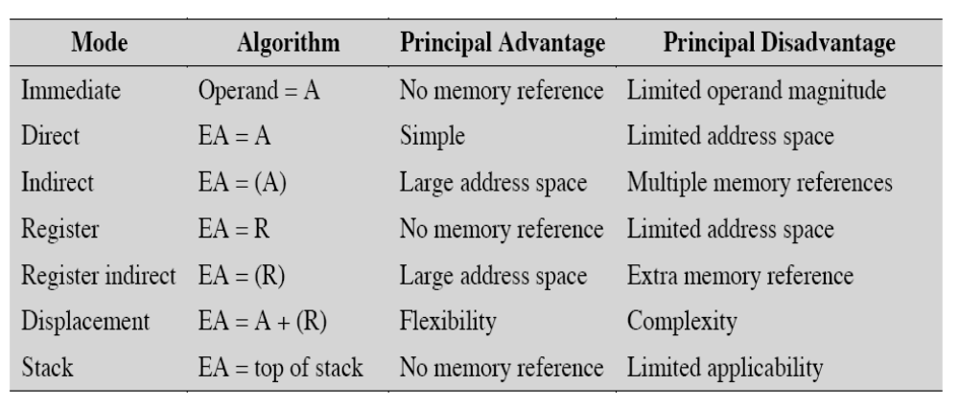
Summary of basic addressing modes

